Slide 1


Using PowerShell Script Change the Owner of MS Flows
Mohammed Shafiuddin

Slide 2
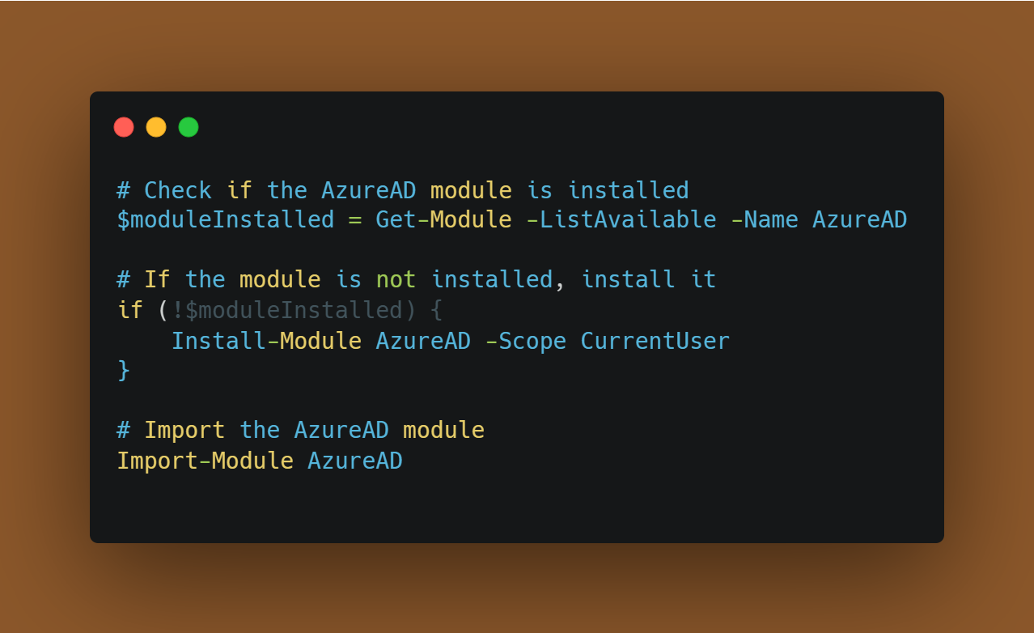
Step 1: Install AZURE AD Module
1) We first check if the AzureAD module is already installed using the Get-Module cmdlet with the -ListAvailable parameter and the module name 'AzureAD'.
2) If the module is not installed ($moduleInstalled is false), it installs the module using Install-Module AzureAD -Scope CurrentUser. The -Scope CurrentUser flag installs the module for the current user only. If you want to install it for all users, you can omit the -Scope parameter or set it to 'AllUsers'.
3) Finally, it imports the AzureAD module using Import-Module AzureAD.
This ensures that the module is installed and available for use in your PowerShell session.
Notes:
# Check if the AzureAD module is installed
$moduleInstalled = Get-Module -ListAvailable -Name AzureAD
# If the module is not installed, install it
if (!$moduleInstalled) {
Install-Module AzureAD -Scope CurrentUser
}
# Import the AzureAD module
Import-Module AzureAD

Slide 3
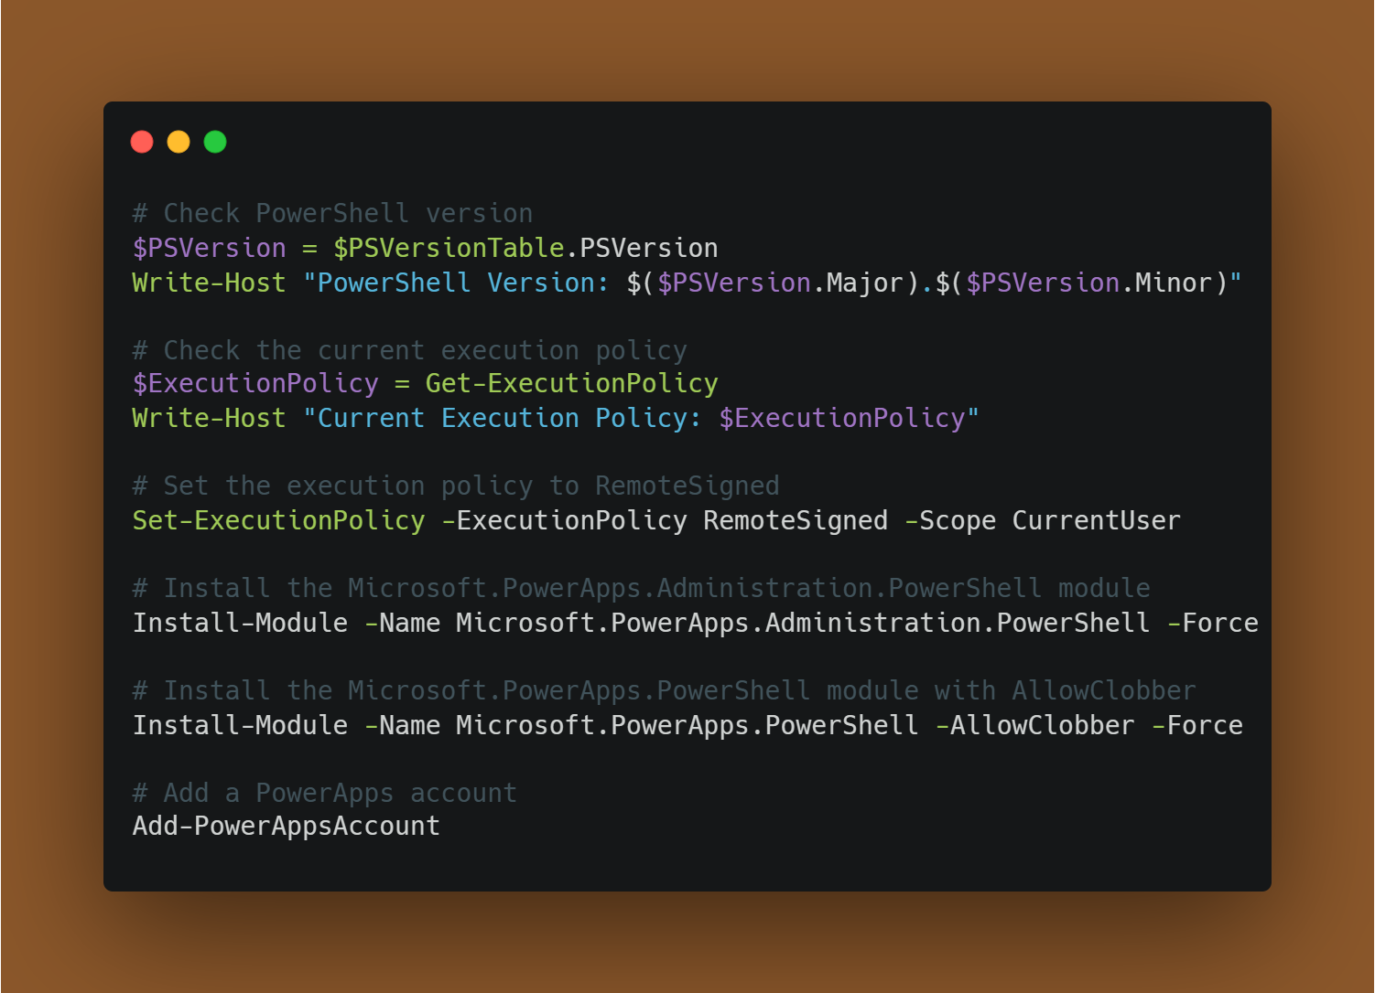
Step 2) Install Microsoft PowerApps
It will check the PowerShell version, the current execution policy, update the execution policy, install the required modules, and add a PowerApps account. Please note that you may need to run PowerShell with administrative privileges if changing the execution policy or installing modules requires elevated permissions.
Notes:
# Check PowerShell version
$PSVersion = $PSVersionTable.PSVersion
Write-Host "PowerShell Version: $($PSVersion.Major).$($PSVersion.Minor)"
# Check the current execution policy
$ExecutionPolicy = Get-ExecutionPolicy
Write-Host "Current Execution Policy: $ExecutionPolicy"
# Set the execution policy to RemoteSigned
Set-ExecutionPolicy -ExecutionPolicy RemoteSigned -Scope CurrentUser
# Install the Microsoft.PowerApps.Administration.PowerShell module
Install-Module -Name Microsoft.PowerApps.Administration.PowerShell -Force
# Install the Microsoft.PowerApps.PowerShell module with AllowClobber
Install-Module -Name Microsoft.PowerApps.PowerShell -AllowClobber -Force
# Add a PowerApps account
Add-PowerAppsAccount

Slide 4
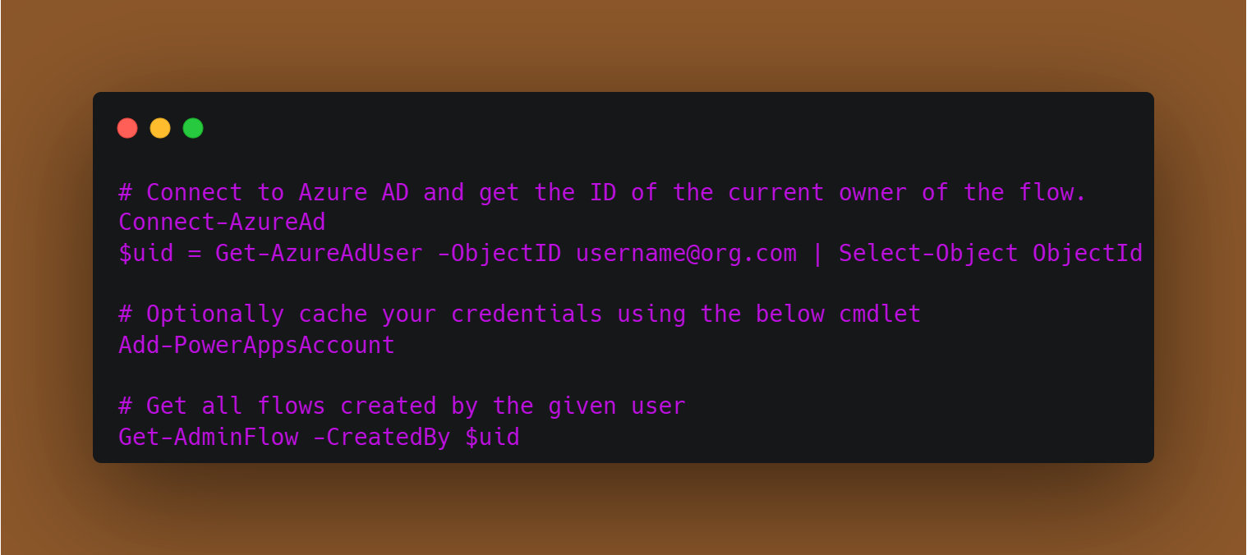
Step 3) Connect to Azure AD and get the ID
Notes:
# Connect to Azure AD and get the ID of the current owner of the flow.
Connect-AzureAd
$uid = Get-AzureAdUser -ObjectID username@org.com | Select-Object ObjectId
# Optionally cache your credentials using the below cmdlet
Add-PowerAppsAccount
# Get all flows created by the given user
Get-AdminFlow -CreatedBy $uid

Slide 5
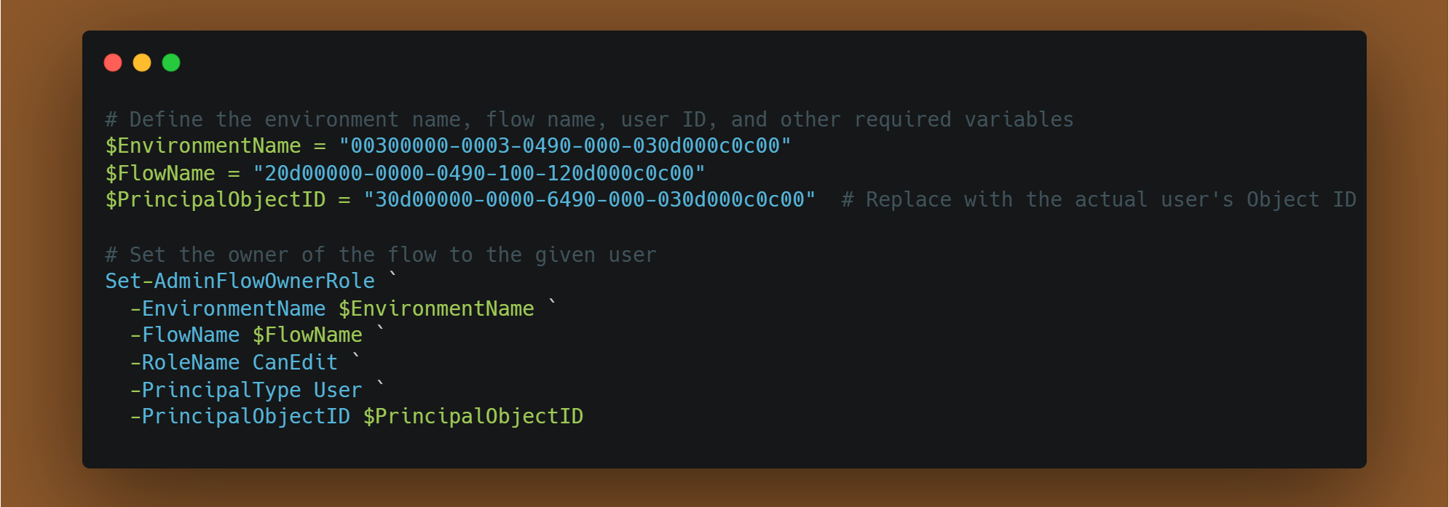
Step 4) Set the owner of the flow to given user
Environment Name: Make sure that the $EnvironmentName variable contains the correct environment name where the flow is located.
Flow Name: Verify that the $FlowName variable contains the accurate Flow ID or Flow name. It should point to the specific flow you want to change the owner for.
User Object ID: Ensure that the $PrincipalObjectID variable contains the Object ID of the user you want to assign as the owner. The Object ID is a unique identifier for the user in Azure Active Directory.
Role Name: You've specified the role as "CanEdit," which is typically used for users who can edit and manage the flow. Make sure this is the desired role for the user.
Notes:
# Define the environment name, flow name, user ID, and other required variables
$EnvironmentName = "00300000-0003-0490-000-030d000c0c00"
$FlowName = "20d00000-0000-0490-100-120d000c0c00"
$PrincipalObjectID = "30d00000-0000-6490-000-030d000c0c00" # Replace with the actual user's Object ID
# Set the owner of the flow to the given user
Set-AdminFlowOwnerRole `
-EnvironmentName $EnvironmentName `
-FlowName $FlowName `
-RoleName CanEdit `
-PrincipalType User `
-PrincipalObjectID $PrincipalObjectID

Slide 6
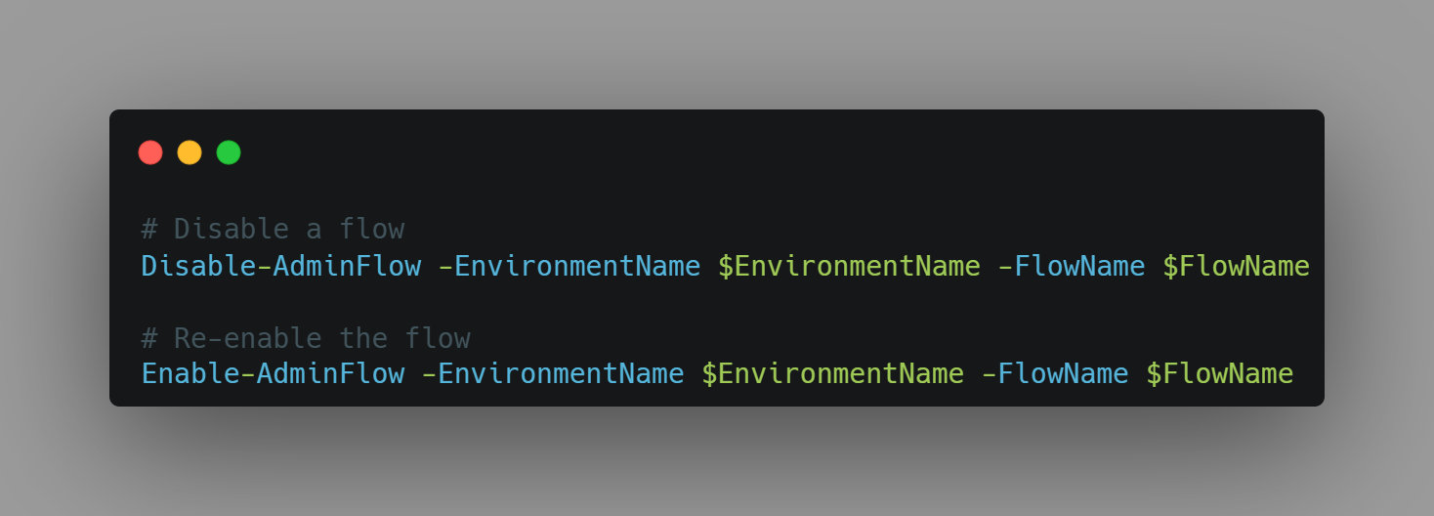
Step 5) Disabling and Enabling Flows
Disable-AdminFlow: This cmdlet allows administrators to halt the execution of a specific flow in a given environment. By specifying the environment name and flow name as parameters, administrators can effectively pause the flow's operation
Enable-AdminFlow: Conversely, Enable-AdminFlow is used to resume the execution of a previously disabled flow. Once the required modifications or investigations are completed, administrators can re-enable the flow to restore normal operations.
Notes:
# Disable a flow
Disable-AdminFlow -EnvironmentName $EnvironmentName -FlowName $FlowName
# Re-enable the flow
Enable-AdminFlow -EnvironmentName $EnvironmentName -FlowName $FlowName

